Slide 1
Hardening the Digital Perimeter: Securing Personal Infrastructure
By Clark neal

Slide 2
Why I'm doing this: The growing need for personal digital sovereignty
Most consumer devices and software leak data constantly
Cloud services are opaque and often violate user privacy through telemetry, advertising, and surveillance.
Individuals have little visibility or control over the systems in their own home
Taking control of your server, network, and systems is a foundational act of digital independence.
"If you are not paying for the product, you are the product.” - Unknown

Slide 3
Why its important: The privacy argument and counter argument
“If you have nothing to hide you have nothing to fear” – Mantra
Privacy is not about hiding wrongdoing—it's about protecting the boundaries of personal freedom, autonomy, and context.
Privacy is about power asymmetry, not secrecy
Historically, mass surveillance has been weaponized
Privacy is a prerequisite for security and reducing vulnerable surface area
“Arguing that you don’t care about the right to privacy because you have nothing to hide is no different than saying you don’t care about free speech because you have nothing to say.” – Edward Snowden

Slide 4
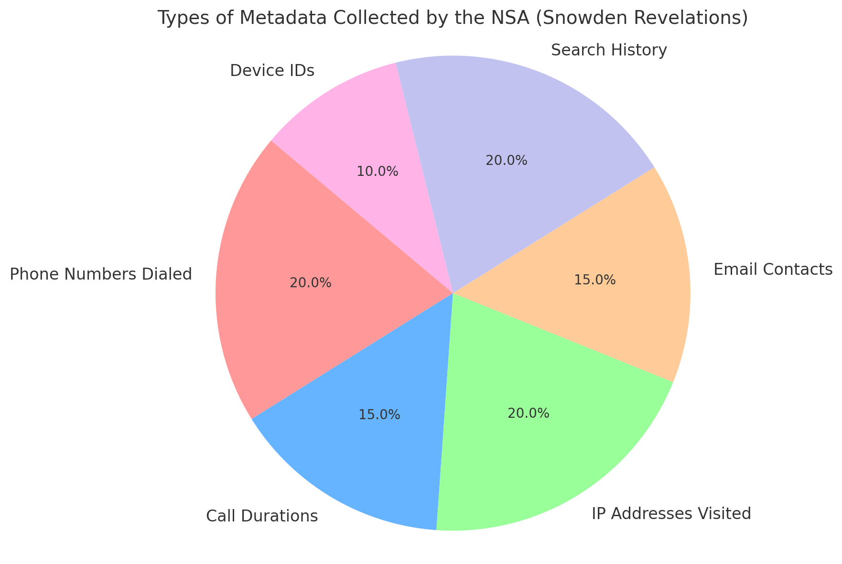
Illustrative Breakdown of Common Metadata Types Collected by NSA (Post-Snowden)

Slide 5
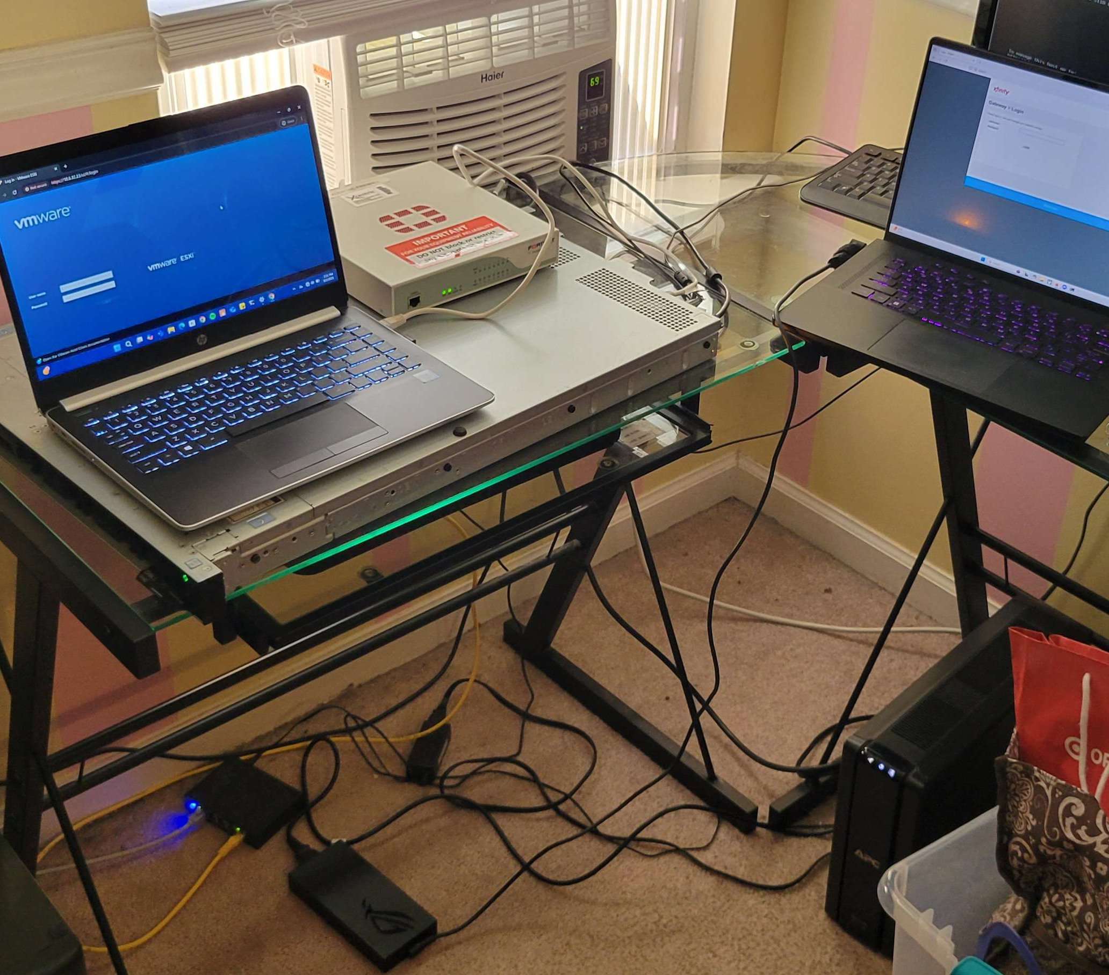
The setup
Dell PowerEdge Server blade
FortiGate firewall (Unimplemented)
VMWare EXSi
Laptop with Anydesk and VPN
Ethernet cable
Windows server 2016
UPS

Slide 6
The project process and initial challenges
The Dell server blade is decommissioned and needs to be reset, but retains old creds
Access to the VMWare OS is gained and the server can now be put on the network
Once a machine is virtualized like Windows server, it can be remoted in to and used for management
Hardware
VMWare
Virtualization

Slide 7
Getting into the hardware
Device came locked up with original credentials
Initially on a static IP from another network
Only valid method of access was via console, but couldn’t connect because of bad credentials
Proper reset would solve problem but kill the premium VMWare OS
Solution was a complicated process of booting a second OS and editing the partition of the original OS where the credentials were
Ultimately this was not necessary as the credentials were located

Slide 8
Setting up VMWare
VMWare systems were user friendly, and no problems were encountered
Server has limited resources, and the out of date but free VMWare software had limited selections
For simplicity, Windows server 2016 was chosen as the management server, it served its purpose but proved problematic

Slide 9
Remoting setup
RDP – Too insecure
SSH – A Reasonable choice, will probably use in the future
Parsec – Failed, needed specific hardware
Teamviewer – Failed, needed money
Settled on Anydesk + Cloudflare warp

Slide 10
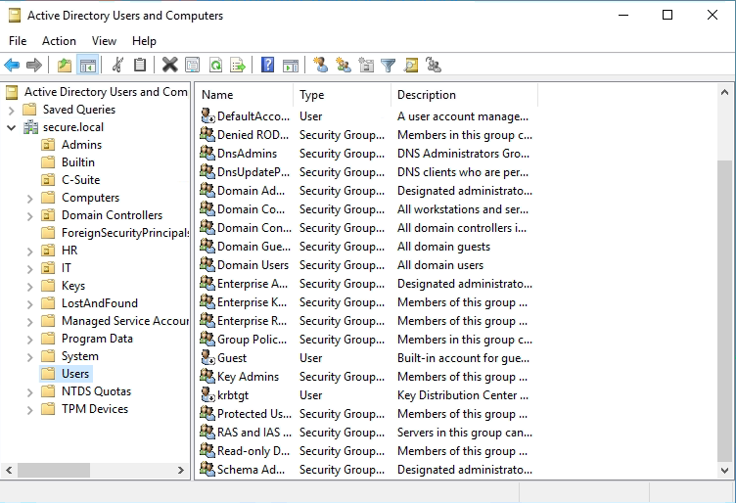
Windows Server Setup
Setting up AD and making server the domain controller
Setting up accounts (Disabling defaults)
Policies, templates
Network-level hardening (disabling RDP, SMBv1, NetBIOS, etc)
Visibility reduction (ICMP, hide from browse lists
Setting up DNS and Nessus

Slide 11
Live demo time!

Slide 12
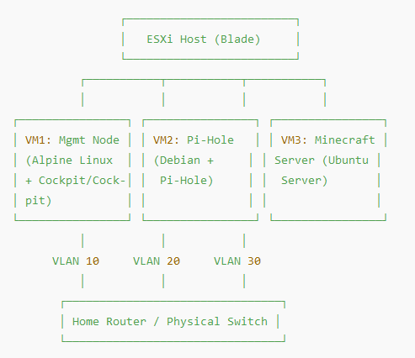
Future development
Separate VMs
Move away from Windows
Network segmentation (VLAN)
Rules for each node
Out of band management
Investigate scrubbing outgoing packets
Nessus scanning

Slide 13
Future development cont.
Block ads and trackers at the DNS level (Pi-hole)
Self hosted DNS with DoH for encrypted lookups
Self hosted IoT like Alexa without connecting to the cloud
Self hosting media, create a digital library (Plex or Jellyfin)
Host your own Git repo or DevOps stack
Run containers for automation

Slide 14


Slide 15
Sources
[1] National Institute of Standards and Technology. Special Publication 800-123: Guide to General Server Security. Gaithersburg, MD (2008).
[2] European Union Agency for Cybersecurity (ENISA). ENISA Threat Landscape 2023. (Oct. 2023).
[3] DoD Zero Trust Engineering Team. DoD Zero Trust Reference Architecture v2.0. Department of Defense CIO (July 2022).
[4] Red Hat, Inc. Red Hat Enterprise Linux 7 Security Guide. (2020).
[5] University of Central Florida. Server Security Standards (Standard 103). UCF Information Security Office (Apr. 2019).
[6] Dell Inc. Networking Best Practices for VMware Infrastructure 3 on Dell PowerEdge Blade Servers (White Paper). (Apr. 2009).

